Slide 1
Nessus Demo - 3
Lets take a look at Nessus Demo
https://www.tenable.com/products/nessus/nessus-professional/evaluate
Download free 7 day trial
Get activation key from website

Slide 2
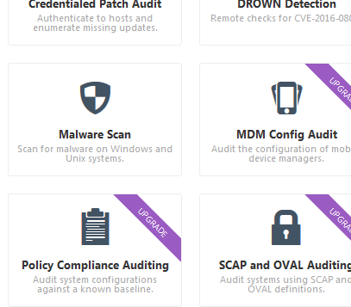
Nessus Demo - 3
SYSTEM MALWARE SCAN

Slide 3
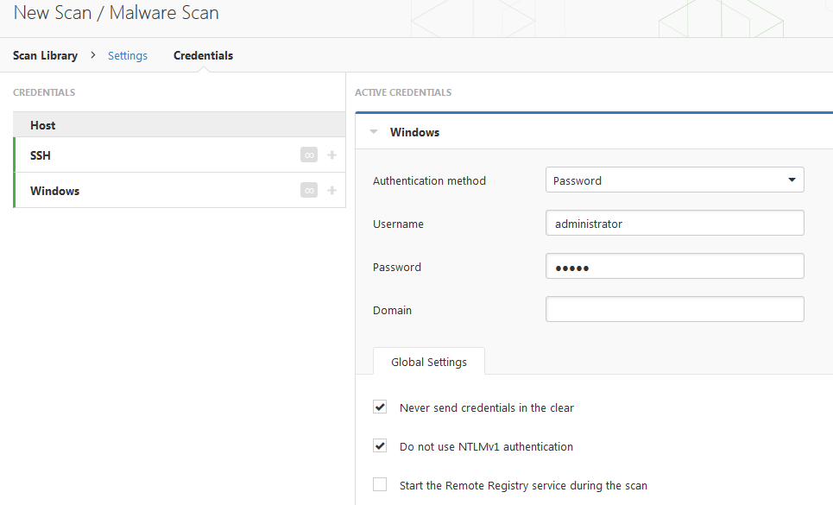
Nessus Demo - 3
SYSTEM MALWARE SCAN

Slide 4
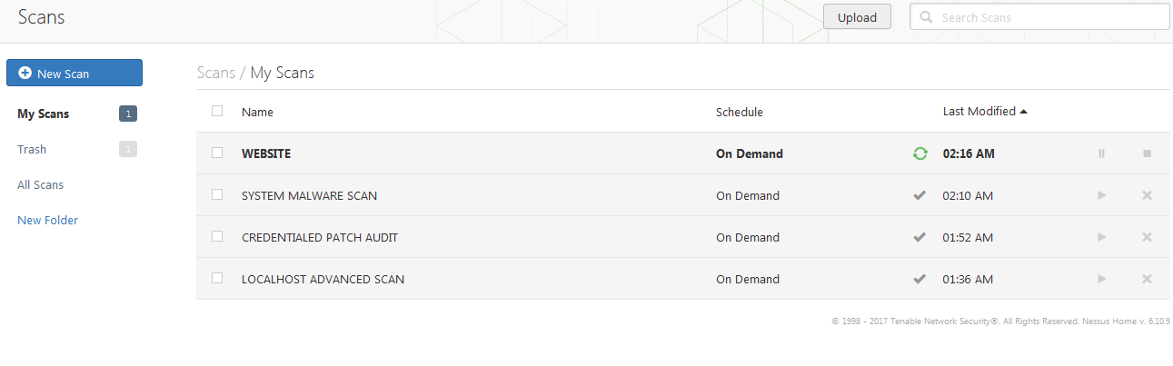
Nessus Demo - 3
SCAN DASHBOARD

Slide 5
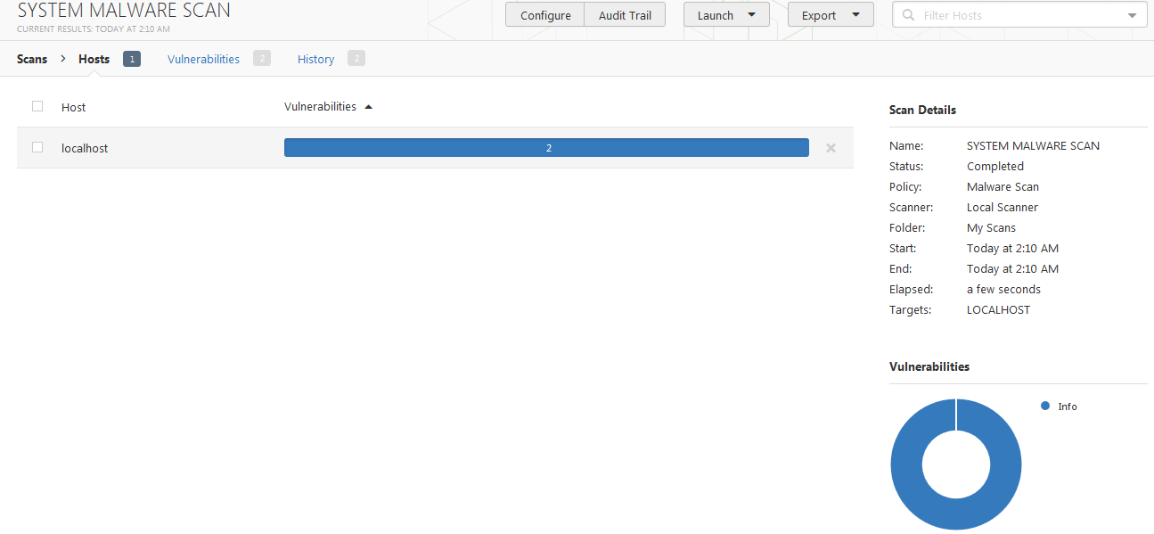
Nessus Demo - 3
SYSTEM MALWARE SCAN [2 INFO]

Slide 6
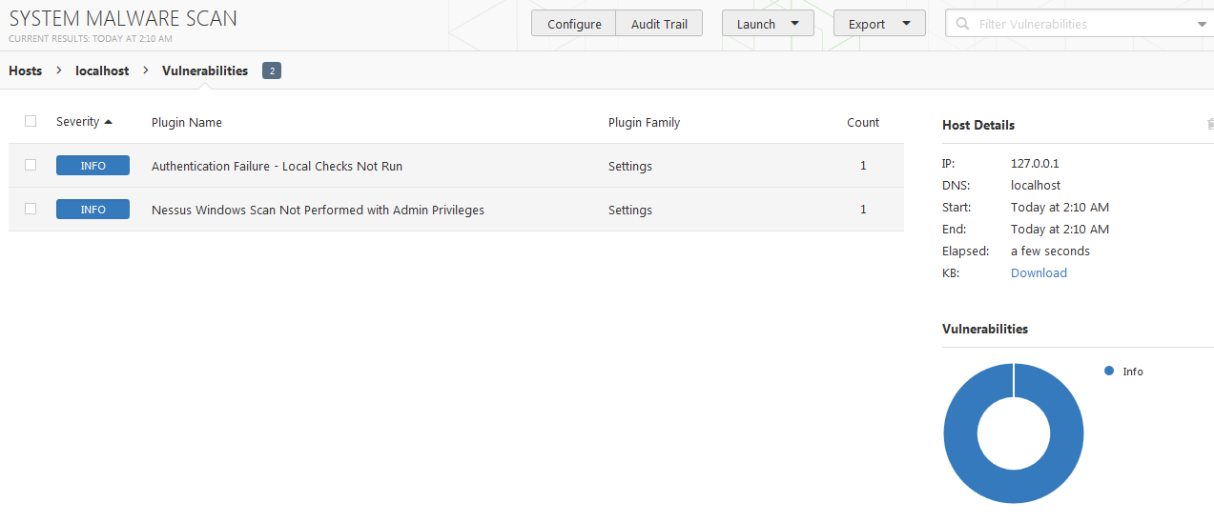
Nessus Demo - 3
SYSTEM MALWARE SCAN

Slide 7
Nessus Demo - 3
Nessus is an easy to use and powerful scanner
Dozens of scans on dashboard
Setup a new scan
Setup a profile as scan template
Credentialed scan
Thousands of plugins from CIS/DISA etc
END

